Slide 1

Profit and Loss

Slide 2
Cost Price: The price, at which an article is purchased, is called its cost price, abbreviated as C.P.
Selling Price: The price, at which an article is sold, is called its selling price, abbreviated as S.P.
Profit or Gain: If S.P. is greater than C.P., the seller is said to have a profit or gain.
Loss: If S.P. is less than C.P., then the seller is said to have incurred a loss.

Slide 3
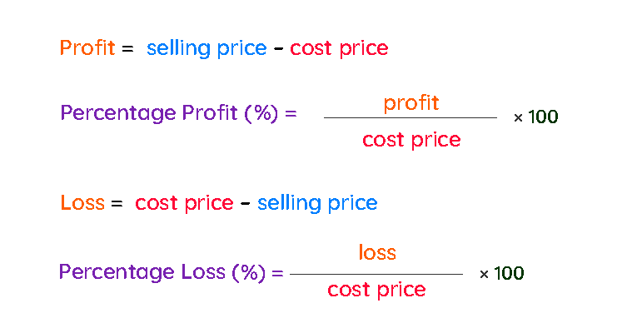

Slide 4
MP= Rs. 600
Discount =Rs.100
Mark up= Rs. 200
SP= Rs.500
Profit
= Rs.100
CP= Rs.400
A shopkeeper buys a T-shirt from whole sale market at Rs.400 and marked that article Rs.200 above the CP. After giving a discount of Rs.100 he sold it at Rs.500.

Slide 5
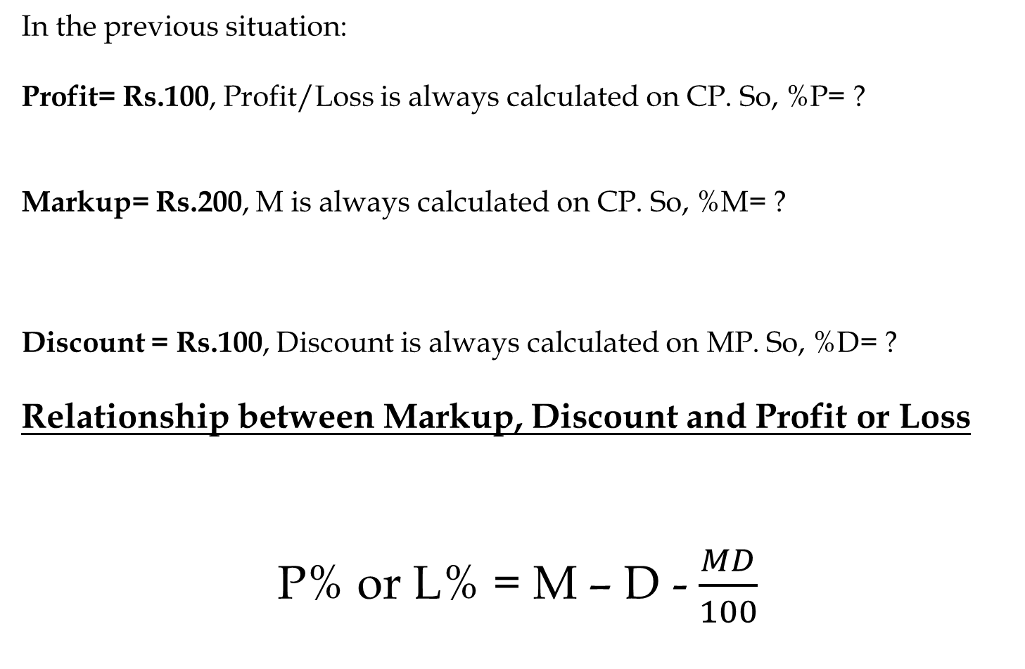
In the previous situation:
Profit= Rs.100, Profit/Loss is always calculated on CP. So, %P= ?
Markup= Rs.200, M is always calculated on CP. So, %M= ?
Discount = Rs.100, Discount is always calculated on MP. So, %D= ?
Relationship between Markup, Discount and Profit or Loss
P% or L% = M – D - $\frac{MD}{100}$

Slide 6
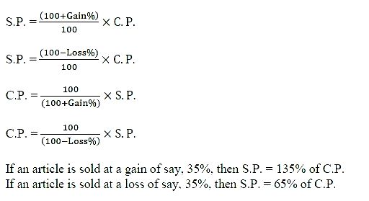

Slide 7
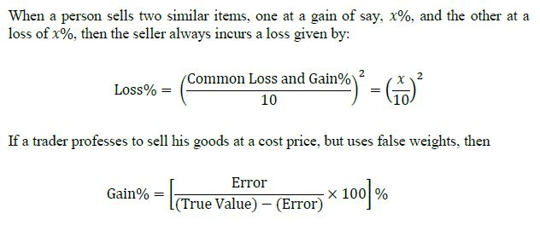

Slide 8
Questions: A TV is purchased at Rs. 5000 and sold at Rs. 4000, find the lost percent.
[A] 10%
[B] 20%
[C] 25%
[D] 28%

Slide 9
CP = Rs.500
P = 20 %
SP = ?
CP = Rs.800
L = 30 %
SP = ?

Slide 10
SP = Rs.720
P = 20 %
CP = ?
SP = Rs. 810
L = 10 %
CP = ?

Slide 11
Questions: When a plot is sold for Rs. 18,700, the owner loses 15%. At what price must that plot be sold in order to gain 15%?
[A] Rs.21000
[B] Rs.22500
[C] Rs.25300
[D] Rs.25800

Slide 12
Questions: Alfred buys an old scooter for Rs. 4700 and spends Rs. 800 on its repairs. If he sells the scooter for Rs. 5800, his gain percent is
[A] 6/19%
[B] 6/11%
[C] 60/11%
[D] 38/11%

Slide 13
Question: If CP of 25 articles is equal to SP of 20 articles. Find the profit or loss percent.
[A] 25% loss
[B] 25% profit
[C] 20 % profit
[D] 20 % loss

Slide 14
Question: If CP of 30 articles is equal to SP of 45 articles. Find the profit or loss percent.
[A] 33.33 % loss
[B] 33.33 profit
[C] 20 % loss
[D] 20 % profit

Slide 15
Question: By selling 12 articles a man earn a loss of which is equal to selling price of 4 articles. Find his loss percent.
[A] 20 %
[B] 25%
[C] 33.33%
[D] 16.66 %

Slide 16
Question: By selling 66m cloths a man earn a profit of equal to selling price of 6m cloths. Find his profit percent.
[A] 20 %
[B] 25 %
[C] 10%
[D] 33.33%

Slide 17
Question: By selling 40 articles a man earn a profit of equal to cost price of 5 articles. Find his loss or profit percent.
[A] 33.33 % profit
[B] 12.5 % loss
[C] 25 % loss
[D] 12.5 % profit

Slide 18
Question: A shopkeeper buy some number of article at the rate of 11 articles for Rs.10 and sold all of them at the rate of 10 articles for Rs.11. Find his profit or loss percent.
[A] 20 % profit
[B] 21% profit
[C] 25 % loss
[D] 21 % loss

Slide 19
Question: A shopkeeper buy some number of article at the rate of 12 articles for Rs.15 and sold all of them at the rate of 10 articles for Rs.14. Find his profit or loss percent.
[A] 20 % loss
[B] 33.33 % profit
[C] 12 % profit
[D] 12.5 % loss

Slide 20
Question: A Shopkeeper buy some lemons at rate of 2 for Rs.1.
Again he bought the some number of lemons at rate of 1 for
Rs.2. He mixed both the types and sold at 3 for Rs.3. find profit
/ loss %.
[A] 20 % loss
[B] 25 % loss
[C] 20 % profit
[D] 25 % profit

Slide 21
Question: A shopkeeper purchase some number of article for Rs.8400. He sold 3/5th of them at 15 % profit each. At what percent profit should he sell the remaining to gain overall 20 % profit.
[A] 26%
[B] 27%
[C] 27.5%
[D] None

Slide 22
Question: A shopkeeper purchase some number of article for Rs.5520. He sold 5/7th of them at 14 % profit each. At what percent profit should he sell the remaining to gain overall 18 % profit.
[A] 20%
[B] 25%
[C] 33.33%
[D] 28%

Slide 23
Question: A shopkeeper purchase some number of article for Rs.4500. He sold 1/3rd of them at 10 % loss each. At what percent profit should he sell the remaining to gain overall 20 % profit.
[A] 30%
[B] 25%
[C] 35%
[D] None

Slide 24
Question: A shopkeeper professes to sell his goods at its CP, But he uses 950 gm. In place of 1 kg. Find his profit percent.
[A] 12.5 %
[B] 25%
[C] 5.26%
[D] 4%

Slide 25
Question: A shopkeeper professes to sell his goods at its CP, But he uses 800 gm. In place of 1 kg. Find his profit percent.
[A] 25%
[B] 20%
[C] 33.33%
[D] 40%

Slide 26
Question: A shopkeeper professes to sell his goods at 10% profit, But he uses 20% less weight. Find his total profit percent.
[A] 37.5%
[B] 45%
[C] 25%
[D] 20%

Slide 27
Question: A shopkeeper professes to sell his goods at 44% loss, But he uses 30% less weight. Find his profit or loss percent.
[A] 20% profit
[B] 25% profit
[C] 25% loss
[D] 20% loss

Slide 28
Question: A shopkeeper selling his goods at 7% loss. Had he sold it for Rs.800 more then he would get 9% profit. Find the CP of that article.
[A] 500
[B] 6000
[C] 5000
[D] 4500

Slide 29
Question: A shopkeeper selling his goods at 20% profit. Had he purchase it 10% less and sold it for Rs.18 less then he would get 30% profit. Find the initial CP of that article.
[A] 540
[B] 600
[C] 1200
[D] 720

Slide 30
Question: A shopkeeper selling his goods at 10% profit. Had he purchase it 20% less and sold it for Rs.20 more then he would get 40% profit. Find the initial SP of that article.
[A] 1000
[B] 2000
[C] 1100
[D] 720

Slide 31
Question: A shopkeeper selling his goods at 30% profit. Had he purchase it for Rs.2700 less and sold it for Rs.2700 less then he would get 10% more profit. Find the initial CP of that article.
[A] 10000
[B] 10800
[C] 12500
[D] None

Slide 32
Question: A shopkeeper sold an article at 25% profit. If the CP and SP are decreased by Rs.20 and Rs.40 respectively then the profit percent would be decreased by 15 %. Find CP of the articles.
[A] 120
[B] 200
[C] 180
[D] 240

Slide 33
Question: A man purchase some number of articles at the rate of 11 articles for Rs.1. How many articles should he sell for Rs.1 to gain 10% profit.
[A] 11
[B] 10
[C] 12
[D] 14

Slide 34
Question: A man purchase 25 articles for Rs.1. How many articles should he sell for Rs.1 to gain 25% profit.
[A] 21
[B] 28
[C] 20
[D] None

Slide 35
Question: By selling 32 articles for Rs.1 a man earn loss of 40 %. How many articles should he sell for Rs.1 to gain 20% profit.
[A] 16
[B] 17
[C] 18
[D] 19

Slide 36
Question: By selling 45 articles for Rs.40 a man earn loss of 20 %. How many articles should he sell for Rs.24 to gain 20% profit.
[A] 20
[B] 27
[C] 18
[D] None

Slide 37
Question: A shopkeeper purchase 2 articles for Rs.9600. He sold the first article at 20% loss and second article at 60% profit then he find that both the articles being sold on the same price. Find the CP of first article.
[A] 6400
[B] 3200
[C] 6000
[D] 5400

Slide 38
Question: A shopkeeper sells 2 articles. He sold the first article at 15% loss and second article at 19% profit. During the whole transaction he earn a loss of Rs90. Find the CP of second article if the SP of both articles are same.
[A] 5000
[B] 4500
[C] 2000
[D] None

Slide 39
Question: A shopkeeper sells 3 articles. He sold the first article at 20% profit, second article at 10% loss and third at 25% loss. During the whole transaction he earn a loss of Rs60. Find the SP of first article if the SP of all the articles are same.
[A] 216
[B] 180
[C] 240
[D] None

Slide 40
Problems on Discount:
Questions: A bag marked at Rs80 is sold for Rs68. The rate of discount is:
[A] 20%
[B] 15%
[C] 17 (11/17)%
[D] 12%

Slide 41
Questions: An item was sold at a price after giving two successive discount of 30% and 50 %. If the selling price of the item was Rs 448, then what was the marked price of the item?
[A] 840
[B] 1280
[C] 1140
[D] 1640

Slide 42
Questions: If after giving a discount of 12%, a profit of 10% was made on an article, then by what % was the price marked up?
[A] 20%
[B] 25%
[C] 32.5%
[D] 35%

Slide 43
Questions: The cost price of a table is Rs 330. It is sold for a profit of Rs 30 after giving 10% discount find its marked price
[A] Rs.400
[B] Rs.380
[C] Rs.420
[D] None

Slide 44
Questions: A sold a table to B at a profit of 15%. Later on, B sold it back to A at a profit of 20%, thereby gaining Rs. 69. How much did A pay for the table originally?
[A] Rs.300
[B] Rs.320
[C] Rs.345
[D] Rs.350

Slide 45
Question: Buy 5 articles get 3 articles free. Find discount percent.
[A] 33.33%
[B] 12.5%
[C] 37.5%
[D] 60%

Slide 46
Question: Buy 2 articles get 1 article free. Find discount percent.
[A] 50%
[B] 33.33%
[C] 20%
[D] 25%

Slide 47
Question: A retailer purchase 70 pens at the mark price of 56 pens and sell them to a customer at their MP. Find the profit percent of shopkeeper.
[A] 25%
[B] 20%
[C] 33.33%
[D] 16.66%

Slide 48
Question: A retailer purchase 40 pens at the mark price of 36 pens and sell them at a discount of 1 %. Find the profit percent of shopkeeper.
[A] 20%
[B] 15%
[C] 10%
[D] None

Slide 49
Question: By how much percent a shopkeeper should mark his goods above its CP so that he will gain 10% profit after giving 30% discount.
[A] 200/7%
[B] 400/7%
[C] 100%
[D] None

Slide 50
Question: By how much percent a shopkeeper should mark his goods above its CP so that he will gain 10% profit after giving 10% discount.
[A] 200/9 %
[B] 110/9 %
[C] 100/9 %
[D] None

Slide 51
Question: A shopkeeper gives 10% discount on an article and earn 20% profit then find his profit percent if he will give 20% discount on the same article.
[A] 16.66%
[B] 5.66%
[C] 6.66%
[D] None

Slide 52
Question: After giving 20% discount a shopkeeper earn 30% profit then find his profit percent if he will give 25% discount on the same article.

Slide 53
Question: A shopkeeper give 1 article free of every purchase of 15 article and also gives a discount of 4 % and after all that his profit percent is 35%. Find CP:MP.
[A] 3:2
[B] 4:5
[C] 3:4
[D] 2:3

Slide 54
Question: A shopkeeper give 4 articles free of every purchase of 12 articles and also gives a discount of 20 % and after all that his profit percent is 20%. Find CP:MP.
[A] 1:2
[B] 2:1
[C] 5:7
[D] 3:2

Slide 55


